Slide 1
SOLAR POWERED , STAND-ALONE , REVOLVING CUSTOMIZABLE SMART STANDEE
PROJECT MEMBERS:
R RAHUL RAJA - 921319105035
S RAKKESH - 921319105039
R RAMJI - 921319105040
V SRI SARAN - 921319105054
PROJECT GUIDE: MR J E MOSHE DAYAN AP/EEE

Slide 2
OBJECTIVES
A standee is a large, self-standing advertising display. Often used to promote movies, products or events.
Standee can be used for point-of-sale advertising and it is also used for creating social awareness for various issues among people.
Popular standee’s often are produced in the form of a life-size cut-out figure of a character or mascot.

Slide 3
INTRODUCTION
The Standee is a mascot that promotes EEE department of PSNA College Of Engineering and Technology.
The power for this standee is assisted by renewable energy.
It can be operated in 5 modes(mode 0 to mode 4).
It is customizable for various shapes and applications.
Standee is designed as a standalone and portable apparatus.

Slide 4
SALIENT FEATURES
Standee consist of 5 Modes(zero to four).
The modes can be controlled through bluetooth.
For standee the primary source is solar power.
The secondary source will be plug-in charging.

Slide 5
COMPONENTS
ARDUINO UNO
It consists of a circuit board, which can be programmed (referred to as a microcontroller) and a ready-made software called Arduino IDE (Integrated Development Environment), which is used to write and upload the computer code to the physical board.
DCMOTOR
DC motors consist of rotor-mounted windings (armature) and stationary windings (field poles). The greatest advantage of DC motors may be speed control.
BATTERY
Range up to – 12A and 5AH.

Slide 6
HC-05 BLUETOOTH MODULE
Send data from Smartphone terminal to HC-05 Bluetooth module and see this data on PC serial terminal and vice versa. To communicate smartphone with HC-05 Bluetooth module, smartphone requires Bluetooth terminal application for transmitting and receiving data.
ISD 1820 ( RECORDER MODULE)
The ISD1820 is a record and playback module that can record a sound and play it whenever required. The module comes with a microphone to record the sound and an 8-ohm speaker to play the recorded sound.

Slide 7
PIR SENSOR
A passive infrared sensor (PIR sensor) is an electronic sensor that measures infrared (IR) light radiating from objects in its field of view.
LDR SENSOR
Light dependent resistors (LDR), are light sensitive devices most often used to indicate the presence or absence of light, or to measure the light intensity.
SOLAR PANEL
Range up to - 12v and 40watts.

Slide 8
MODES OF OPERATION
Mode-0 , it is a normal stand alone mode that illuminates.
Mode-1, the standee has light and it rotates.
Mode-2 , PIR sensor detects the movement and it rotates along with voice note.
Mode-3, the standee stops its rotation upon detecting movement.
Mode-4, it is a night mode, In highways LDR sensor detects the vehicle’s head light and start glowing.

Slide 9

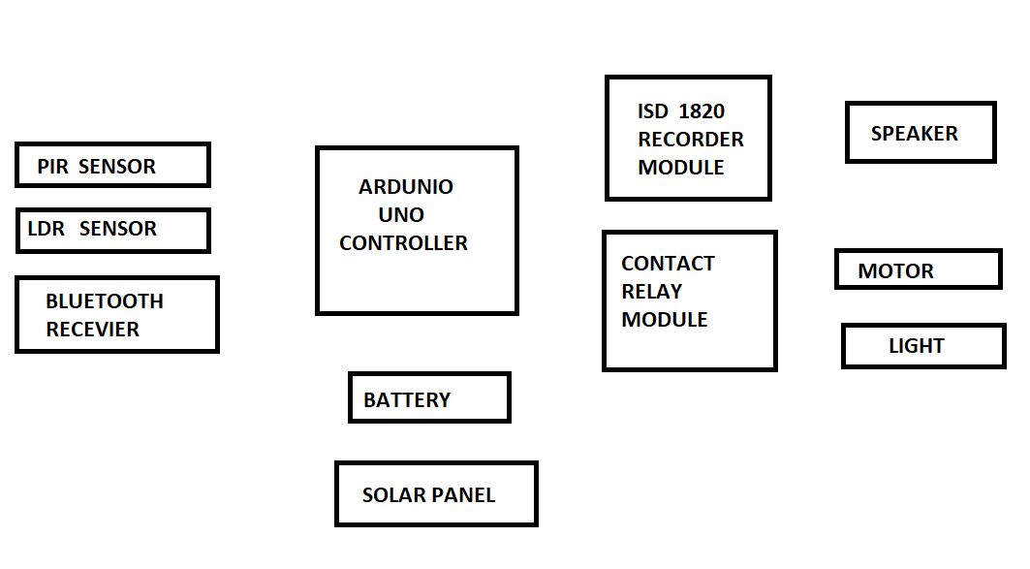

Slide 10
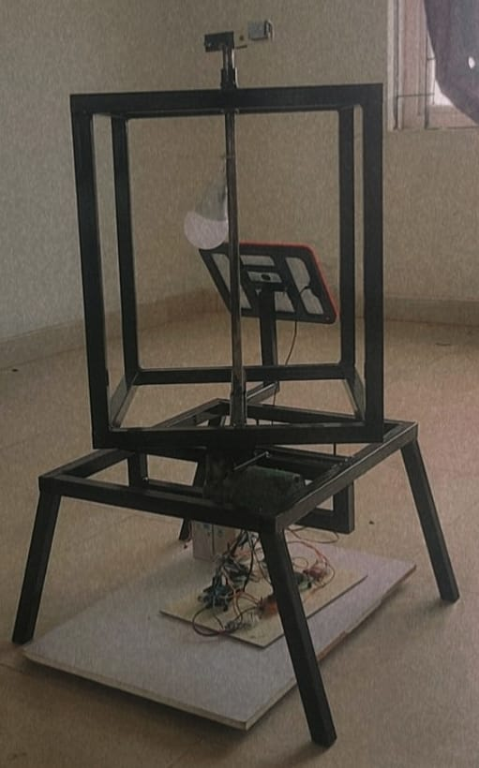
CONSTRUCTION
It consist of two parts :Upper part and Lower part.
Both the parts are connected by a rod attached with motor.
The upper part mainly consist of sensors and used for screening advertisement.
The lower part consist of control circuits,motor,solar panel and battery.

Slide 11
ADVANTAGES
The standee can be personalized according to each Customer’s Experience.
It provides good element of surprise for the users.
It seeks more attention among people.
It is portable.
It is renewable source.

Slide 12
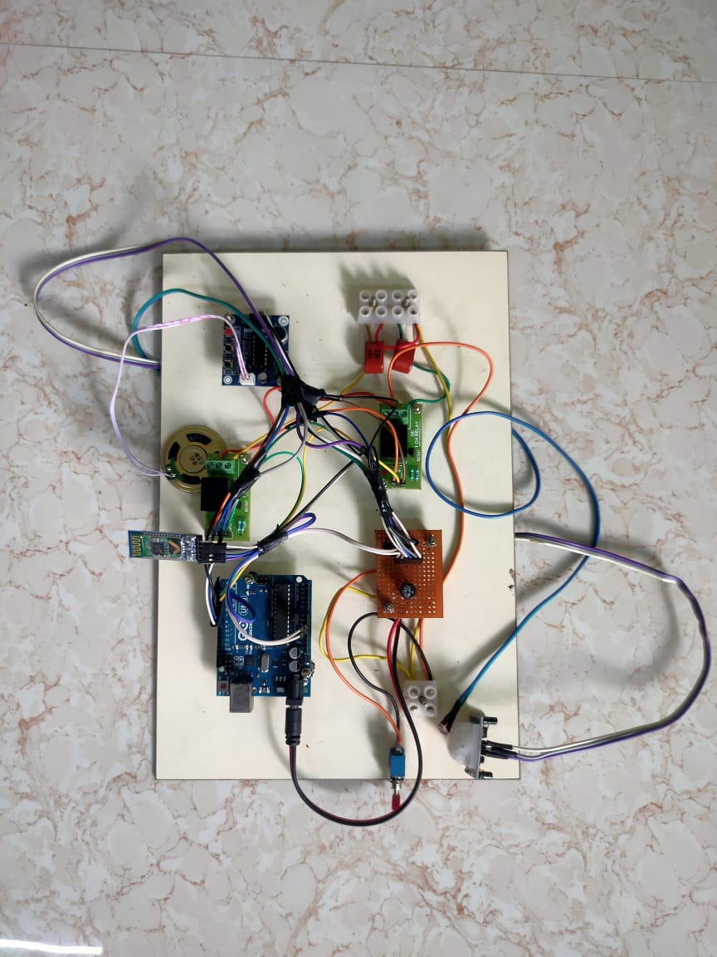
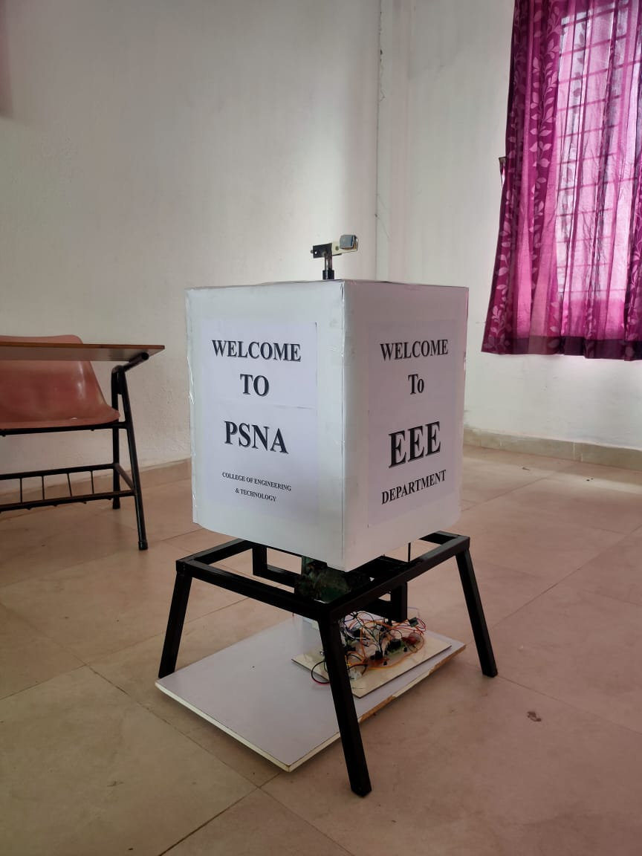
FINAL OUTPUT

Slide 13
REFERENCES
T.Agocs, T.Balogh, T.Forgacs, F.Bettio, E.Gobbetti, G.Zanetti, E.Bouvier: A large scale interactive holographic display; Proc. VR 2006 (workshop on emerging display technologies), 2006.
Dharmendra Kumar Sharma, Vineet Tiwari, Krishnan Kumar, et.al, “Small and Medium Range Wireless Electronics Notice Board using Bluetooth and Zig Bee”, IEEE INDICON 2015.
Pooja Pawar, Suvarna Langade, Mohini Bandgar “IOT Based Digital Notice Board using Arduino ATMega328”.
M. Arun, P. Monika, G. Lavanya 2016 “Raspberry Pi Controlled Smart e-Notice board using Arduino”, IJCAT 2016.

